Slide 1
Medebra
for review of clinical value

Slide 2
Summary of Clinical Advantages
Created by patients for patients with surgeon approval
Patented body design
Patient-oriented strap design
Secure drain pouches
Versatile prosthetics
Smart Velcro design to prevent patient irritation
Efficacious for a variety of post-op recoveries
Testimonials for improved quality of care

Slide 3
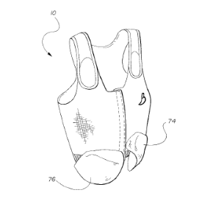
Body Design
Label on outside of garment prevents rubbing against skin and easy identification of sizing
Front closure design allows for easy access for patients and health providers
Loose underarm design to prevent pressure on lymph nodes and promote drainage
97% cotton absorbs fluids to prevent infection and spilling
Cotton and mix of Lycra give the support to flush fluids in the chest due to trauma from surgery
Bottom of garment comes below sutures to prevent painful catching or scraping of material

Slide 4
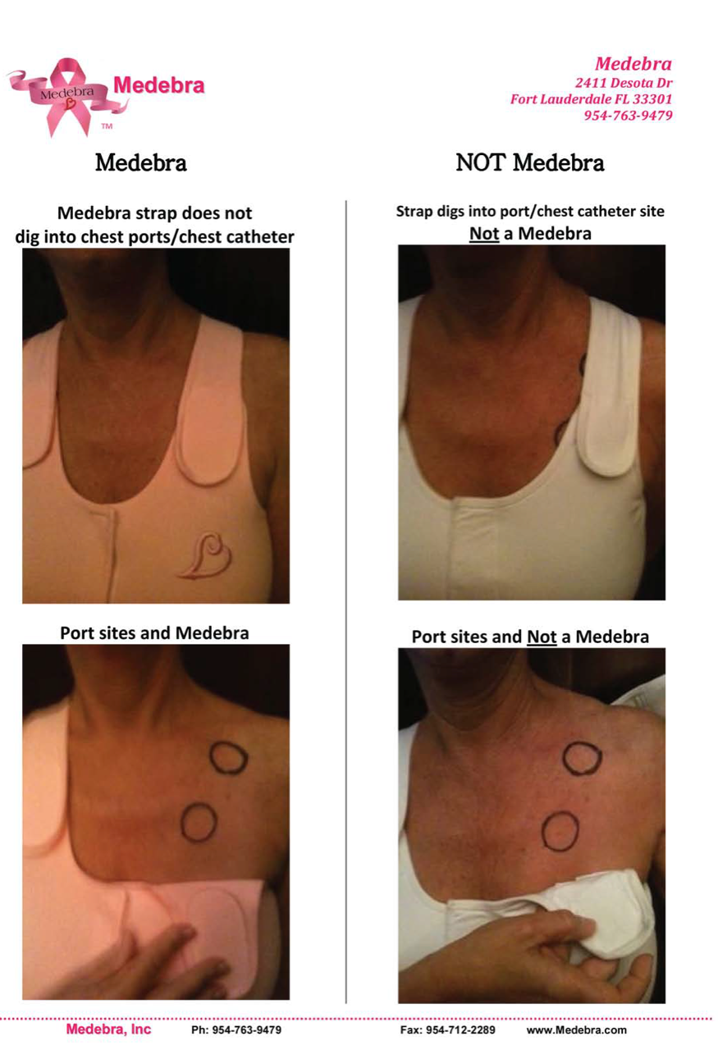
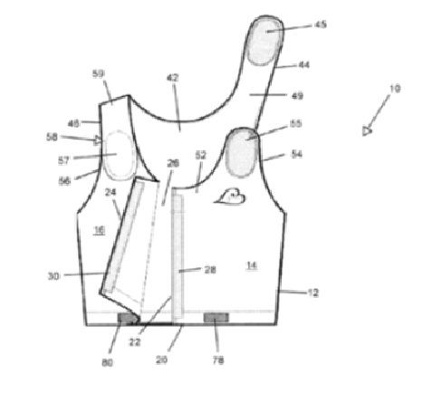
Strap Design
Eliminates need for patients to lift their arm post-surgery thus improving quality of recovery
Allows easy access for healthcare provider and patient
Wide strap design to avoid edges digging into port areas while remaining secure
Medebra vs. Competitors
Demonstration

Slide 5
Drain Pouches
Pouches are easily replaced and washed to cut back on infections
Pouches can be turned into a set of prosthetics post-drainage
Made with absorbent materials to prevent leakage
Pouch design strategically placed to avoid pulling and allow for movement and position for comfort to the patients

Slide 6
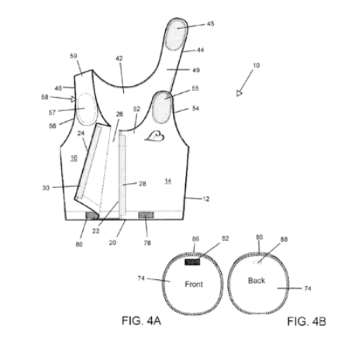
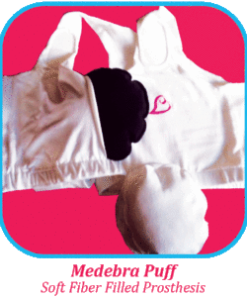
Prosthetics & Velcro
Reimbursable through insurance to limit costs to patient
1/8” margin Velcro with 1” space designed not to scratch the patient
Physically attached to garment to prevent prosthetics from falling to ground and picking up germs
Adjustable, washable pouches to decrease infections

Slide 7
Included but not limited to:

Slide 8
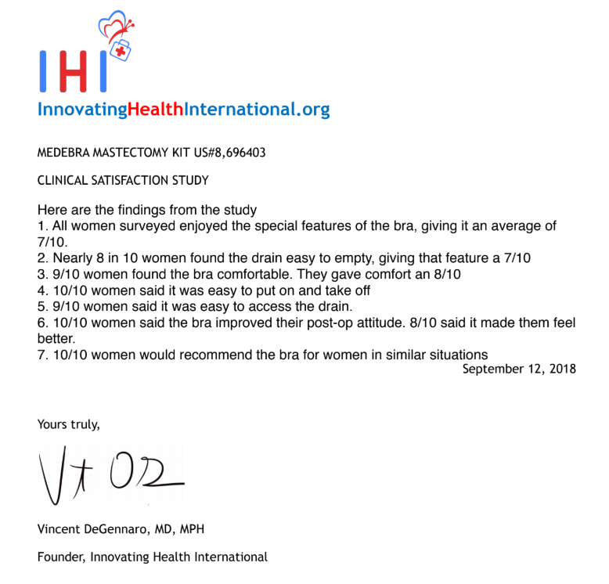
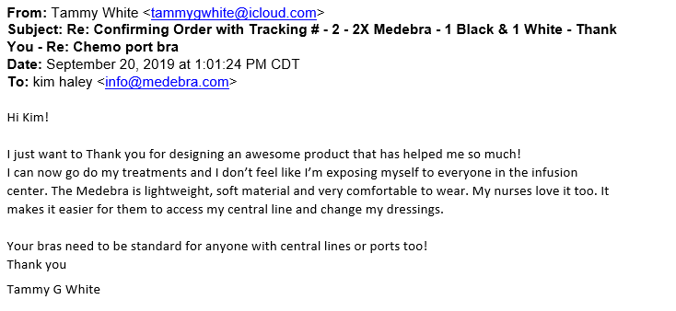
Testimonials and Clinical Trials

Slide 9
Additional Information

Slide 10
Thank you for your consideration!

